Slide 1
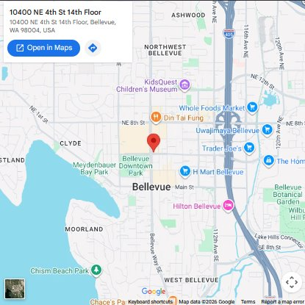
Adventure Aquarium
Did you know? Crabs walk sideways and use their strong claws for defense and finding food.
The Sealife
Opening Times
Search

